Slide 1
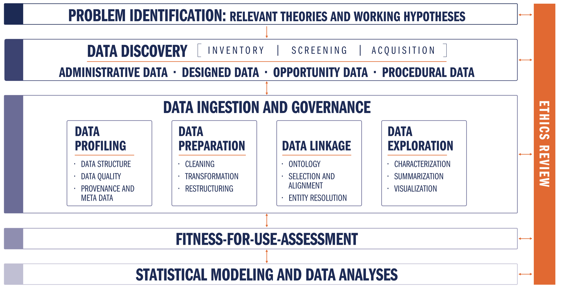
CLD3 - Data Science Processes for Evidence-Based Policy

Slide 2
CLD3 - Data Science Processes & Platforms for Evidence-Based Policy
DETAIL

Slide 3
SDAL
Data Science Processes & Platforms
for Evidence-Based Policy
Data Analytics Process
Data Fitness Analysis
Data Analysis & Hypothesis Testing
Creation of Community Data Tools
Data Fitness Analysis
Profiling
Preparation
Linkage
Exploration & Assessment

Slide 4
Data Science Processes & Platforms for Evidence-Based Policy
Community Discovery Process
Facilitate preliminary problem identification & hypothesis generation starts with critical community-leader-defined issues and good contextual assessment
THIS SHOULD TAKE A LONG TIME
Biggest BANG for the BUCK for facilitated sessions is here
Conduct data management system status discovery to ascertain methods and technologies currently employed
Determine data storage and management capacity requirements of the entire process
Conduct data analytics capabilities assessment – are they going to use a statistical model you build? Or do they just need better counts?
Conduct data discovery and inventory process to identify potential data sources related to the specific issue areas
Deploy data connection technologies as required by an already established data access plan to enable the data transfer and management
TAKE THE TIME TO PERMIT FOCUS TO OCCUR
TAKE THE TIME TO PERMIT FOCUS TO OCCUR
TAKE THE TIME TO PERMIT FOCUS TO OCCUR

Slide 5
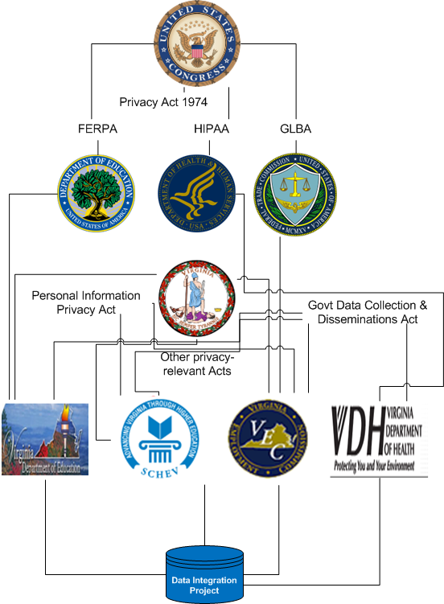
Data Science Processes for Evidence-Based Policy
Community Discovery Process
Situation Analysis & Hypothesis Generation: Context, Stakeholders, Joint-Visioning
Example: Implementation Environment of the Virginia Longitudinal Data System
Multiple levels of statutory law
Multiple implementations of regulatory law at each level of statutory law
Most conservative interpretation of regulatory law becomes de facto standard
“No one person , inside or outside a government agency, should be able to create a set of identified linked data records between partner agencies”
Has a direct and significant effect on the potential success of the technical approach chosen – A Centralized, Hierarchical Data Warehouse will likely Fail!
Easy to see, if you look for it!

Slide 6
Learn the Language! e.g. Virginia Towns

Slide 7
Data Discovery & Inventory
The first step preliminary inventory
identify which sources are worthy of a deeper screening
includes 6 questions and a qualitative evaluation of purpose, data collection method, timeliness, selectivity, accessibility, and description

Slide 8
Data Discovery & Inventory
Conducted on a selected subset from inventory
Much deeper dive
Output is a subset of data sets selected for acquisition and initial analysis of their fitness for analysis

Slide 9
Data Science Processes for Evidence-Based Policy
Data Management Process & Platform
Establish type and method of data transfer
pushed to or pulled into the cooperative platform?
staying where it is and being dynamically queried in a federated manner as needed?
Establish the best transfer protocol(s) to use given the types and method of transfer
e.g. SFTP, secure Dropbox, secured REST API, VT SAFR-Data Adapter for secure federated queries
Establish designed collection systems (e.g. behavioral experiments)
Establish data marshaling processes
system mediation logic, data pipeline and data transformation, transfer schedule, and data provenance maintenance
Establish secure data storage procedures
e.g. each project being stored on a new project-dedicated encrypted partition, original data being stored as non-removable and non-editable

Slide 10
Data Science Processes for Evidence-Based Policy
Data Information Process & Platform
The Lexicon: an inventory of and history of changes to:
every available data field in every available data source
the structure of their storage
possible values and meanings of the information
possible transformations of each set of field values from one data source to another another data source
methods of data source access
matching algorithms and how they are to be used in conjunction with possible field value transformations
Provides fundamental functions for the operation of the framework and is a requirement that the data information be collected from all partner communities
Enables removal of much complexity required for high quality data linkage
i.e. No enforcing data standardization schemes on data partners

Slide 11
Data Science Processes for Evidence-Based Policy
Data Information Process & Platform
Federated Data Linkage
Social Service Agency
Social Service Data
NewID
Gen
FIPS
SES
Data Adapter
7
F
51059
Med
Firewall
2
F
51059
Low
Ordered and Chaffed One-Way Hashes
9
M
51059
High
Education Data
Education Agency
Probabilistic Matching
NewID
Attend
ACT
SAT
7
.97
32
1580
2
.71
18
2110
9
.86
22
1360
Employment Data
NewID
Type
Length
perHr
7
0310
36
16.25
Employment Agency
2
0340
6
22.50
9
7800
21
13.75
Schroeder, A.D. (2012). Pad and Chaff: Secure Approximate String Matching in Private Record Linkage. Proceedings of the 14th International Conference on Information Integration and Web-based Applications and Services (iiWAS '12). pp. 121-125. DOI=10.1145/2428736.2428757. ACM, New York, NY, USA.
https://github.com/dads2busy/SAFRLink-DataAdapter
https://github.com/dads2busy/SAFRLink-Identity
https://github.com/dads2busy/SAFRLink-Crypto

Slide 12
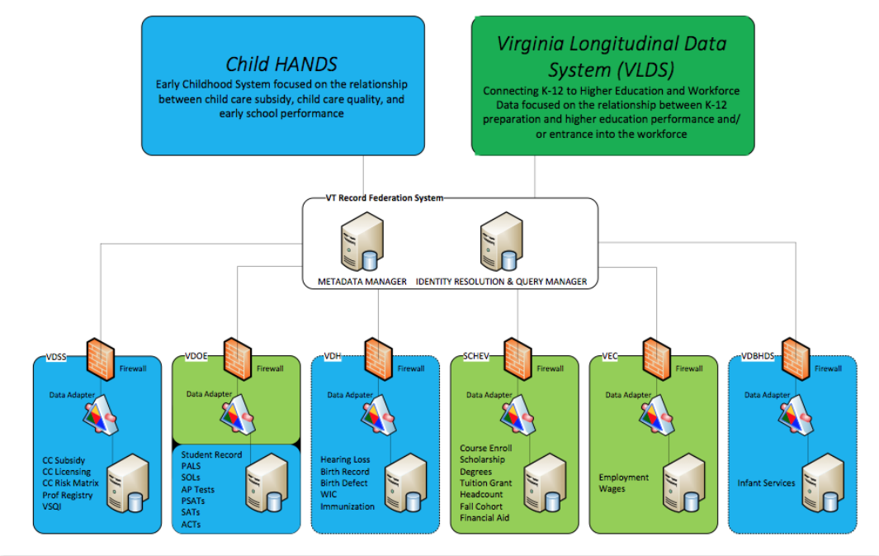
Data Science Processes for Evidence-Based Policy
Data Information Process & Platform
Federated Data Linkage
Schroeder, A.D. (2012). Pad and Chaff: Secure Approximate String Matching in Private Record Linkage. Proceedings of the 14th International Conference on Information Integration and Web-based Applications and Services (iiWAS '12). pp. 121-125. DOI=10.1145/2428736.2428757. ACM, New York, NY, USA.
https://github.com/dads2busy/SAFRLink-DataAdapter
https://github.com/dads2busy/SAFRLink-Identity
https://github.com/dads2busy/SAFRLink-Crypto

Slide 13
Data Science Processes for Evidence-Based Policy
Data Analytics Process
Data Fitness Analysis (Data Re-Purposing)
Modeling is a function of the research question (the use) – drives all data actions
Fitness assessment is about fitness of the data for the model
Fitness is a function of the model, data quality needs of the model, and data coverage (representativeness) needs of the model
When using multiple data sources, fitness will need to assess linking across data sources
Fitness must characterize information content in the results
Accuracy and precision

Slide 14
Data Science Processes for Evidence-Based Policy
Data Analytics Process
Data Fitness Analysis
Data Profiling
Structure
Quality
Provenance & Metadata
Data Preparation
Data Linkage
Data Exploration
Data Analysis & Hypothesis Testing
Creation of Community Data Tools

Slide 15
Repurposing Data for Statistical Purposes
Data Fitness Analysis: Profiling
Structure, Quality, Metadata & Provenance
Missing Variables
values in column headers instead of variable names
e.g. Value-ranges being used as column headers (0-9|10-19|20-29|…)
Combined Variables
more than one variable represented in a attribute (column) value
e.g. An attribute combining gender and age (m25, f32,...)
Multiple Observation Directions
variables in both columns and rows
e.g. A dataset with an element(column) for each day of the month (horizontal) and an element(column) for 'month' (vertical)
note. the messiest and can be dealt with multiple ways according to the needs of the specific analysis
Combined Observation Unit Types
more than one observation unit type per table
e.g. A table containing both individual demographic data and a periodic measurement like weekly attendance where demographic data and weekly attendance are separate observational units and need to be in separate datasets.
Divided Observation Unit Type
observation unit type is split among multiple tables
e.g. Individual demographic information split among several datasets; for example, separate tables for gender, ethnicity, and surname.

Slide 16
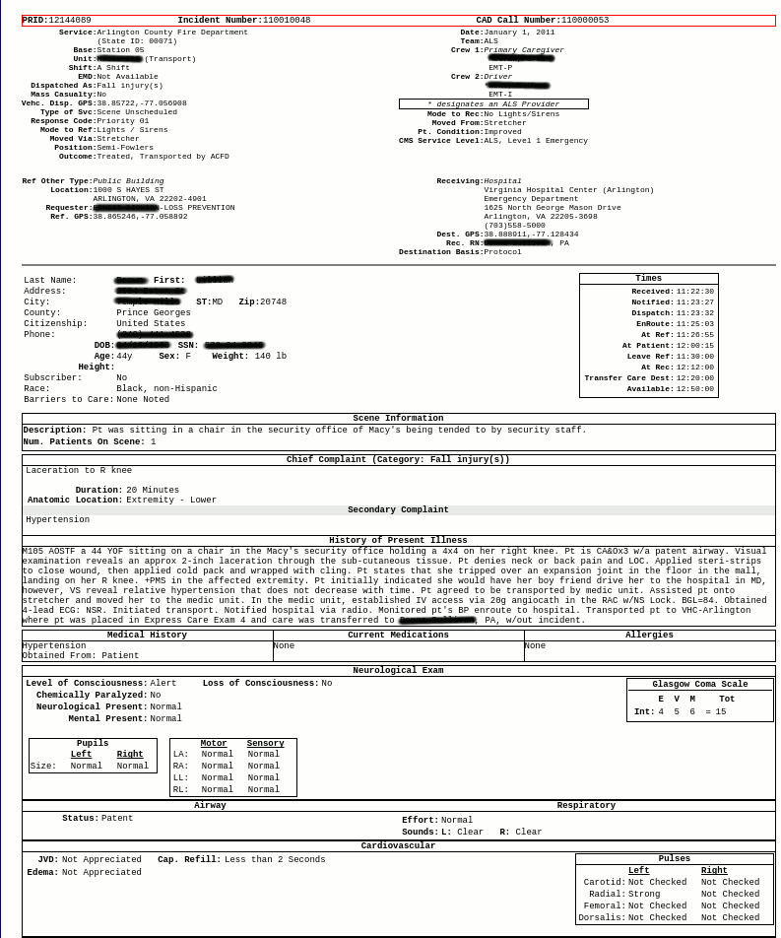

Repurposing Data for Statistical Purposes
Data Fitness Analysis: Profiling
Structure, Quality, Metadata & Provenance
Missing Variables
Emergency Services Data Processing Example
Values of a variables used for column headers

Slide 17
Repurposing Data for Statistical Purposes
Data Fitness Analysis: Profiling
Structure, Quality, Metadata & Provenance
Combined Observation Unit Types
Current Structure of Williamsburg MLS Data
List Number |  | Agency Name | Agency Phone | Agency Email | Listing Agent | Listing Agent Phone | Listing Agent Email | Co-Listing Agent | Property Type | Card Format
 | Book Section | Selling Agency | Selling Agency Phone | Selling Agency Email | Selling Agent | Selling Agent Phone | Selling Agent Email | Co-Selling Agent | End Date | book_sec
 | Listing Date | Sold Date | Under Cont. Date | Fall-thru Date | Status | Status Change | Withdraw Date | Cancel Date | Contingent | Cont. Remarks
 | Orig. List Price | Price | Sold Price | high_price | Low Price | assessed_val | Partial Tax Assmnt | financing | Area | Relocation
 | St. # | box_nbr | St. Dir. | Street Name | Address 2 | streetdirsuffix | Street Suffix | carrier_route | City | State
 | county | country | Zip Code | geo_county | Taxes | geo_lat | geo_lon | Est. Fin. SqFt | sqft1 | sqft2
 | sqft3 | sqft4 | Year Built | 2+ Bdroms on 1st Flr | Realtor.com Type | lot_size | Total Acres | Condo Level | sell_broker_comm | Variable Commission
 | stories | Total Rooms | Total Bedrooms | total_bath | Baths - Full | Baths - Half | baths_3_4 | Garage Type | garage_stall | Water Frontage
 | Zoning | taxes | Tax Year | Subdivision | Public Remarks | Agent Remarks | Parcel ID | Legal Description | Directions | Foreclosure
 | Owner Phone | Owner Name | Neighborhood | mod_timestamp | Ltd Service Agent | Occupied By | Owner/Agent | Mster Bdrm 1st Floor | SqFt Source | Listing Type
 | # Stories | # Fireplaces | Golf Frontage | IDX Y/N | Supplement Attached | Seller Concession(s) | Special Assmnts | Type | Rollback Taxes | userdefined16
 | SellingBroker Incent | Ownership | Describe Concession | How Sold | Selling Broker Comp | userdefined22 | Assessed Value | Est.Unfinished Sq Ft | Tax Rate | Garage Bays
 | userdefined27 | userdefined28 | userdefined29 | userdefined30 | Est. Closing Date | userdefined32 | userdefined33 | Lot Description | Short/CompromiseSale | userdefined36
 | userdefined37 | userdefined38 | userdefined39 | userdefined40 | userdefined41 | userdefined42 | userdefined43 | userdefined44 | userdefined45 | userdefined46
 | userdefined47 | userdefined48 | userdefined49 | userdefined50 | userdefined51 | userdefined52 | userdefined53 | userdefined54 | userdefined55 | userdefined56
 | Photo URL | Days on Market | Rooms | Features
This is a single record with 128 fields all keyed to the variable “List Number”
Structured this way, it is not possible to analyze property changes over time
Pulling out a definitive list of unique properties using “Parcel ID” seems like a possibility
However, “Parcel ID” is left blank in over 7% of entries – extra work required – perhaps including address, but address is not standardized

Slide 18
Repurposing Data for Statistical Purposes
Data Fitness Analysis: Profiling
Structure, Quality, Metadata & Provenance
Combined Observation Unit Types
Ideal Restructuring of MLS Data
Property Characteristics
∞
Property ID
&
Location
Property Sales Information
1
∞
Property Tax Information
∞

Slide 19
Repurposing Data for Statistical Purposes
Data Fitness Analysis: Profiling
Structure, Quality, Metadata & Provenance
Combined Observation Unit Types
Unit Information
Emergency Services Data Processing Example
Scene Information
Multiple Types of Observation on Single Page
Additionally:
Forms made available online as nested HTML Tables - each needing separate extraction
Neurological Information

Slide 20
Repurposing Data for Statistical Purposes
Data Fitness Analysis: Profiling
Structure, Quality, Metadata & Provenance
Divided Observation Unit Types
gender1 id gender2
F 43XXX13 M
F 43XXX14 M
M 76XXX46 F
F 74XXX98 M
F 76XXX23 M
F 77XXX40 M
M 74XXX98 F
M 78XXX73 F
F 78XXX74 M
M 77XXX84 F
F 79XXX87 M
M 71XXX95 F
M 21XXX96 F
M 71XXX54 F
F 71XXX55 M
F 77XXX86 M
F 80XXX24 M
M 76XXX79 F
NC Student Data
Demographics Recorded in Multiple Tables
Actual 2011 data from different tables linked via unique ID
Many more tables with apparently separately collected demographics
Derivation of Demographic Truth is now Probabilistic

Slide 21
Repurposing Data for Statistical Purposes
Data Fitness Analysis: Profiling
Structure, Quality, Metadata & Provenance
Completeness
percentage of elements properly populated
e.g. Testing for NULLs and empty strings where not appropriate
Value Validity
percentage of elements whose attributes possess meaningful values
e.g. A comparison constraint like {male; female} or an interval constraint like age = [0,110]
Consistency
a measure of the degree to which two or more data attributes satisfy a well-defined dependency constraint – relationship validation
e.g. Zip-code – state consistency or gender – pregnancy consistency
Uniqueness
the number of unique values taken by an attribute, or a combination of attributes in a dataset
e.g. Frequency distribution of an element
note. The more homogeneous the data values of an element, the less useful the element is for analysis
Duplication
a measure of the degree of replication of distinct observations per observation unit type
e.g. Greater than 1 registration per student per official reporting period
note. Duplication occurs as a result of choice of level of aggregation

Slide 22
Repurposing Data for Statistical Purposes
Data Fitness Analysis: Profiling
Structure, Quality, Metadata & Provenance
Completeness
Seems straight-forward -- Nope
A set of data is complete with respect to a given purpose if the set contains all the relevant data for that purpose
A common measure is the proportion of data that has values to the proportion that “should” have values.
Completeness is application-specific
Incorrect to simply measure number of missing field values in a record without considering which fields are necessary
MLS Data had MANY highly incomplete fields that were not necessary for the study at hand
Data that are missing can be categorized as:
record fields not containing data
records not containing necessary fields
datasets not containing the requisite records

Slide 23
Repurposing Data for Statistical Purposes
Data Fitness Analysis: Profiling
Structure, Quality, Metadata & Provenance
Value Validity
Data elements with proper values have value validity
The percentage of data elements whose attributes possess values within the range expected for a legitimate entry is a measure of value validity
Checking for value validity generally comes in the form of straight-forward domain constraint rules
How many entries contain non-valid values for a non-empty text field representing gender?
< count gender where gender is not (male, female) >
How many entries contain non-valid values for a non-empty integer field representing age?
< count age where age is not between [0, 110] >

Slide 24
Repurposing Data for Statistical Purposes
Data Fitness Analysis: Profiling
Structure, Quality, Metadata & Provenance
Value Validity
Pulled from current James City County MLS Data
zip_code | area | subdivision | neighborhood | zoning | parcel_id
23185 | JCC | Governors Land | River Reach | R-4 | 4511000022
23188 | JCC | Wellington |  | RESIDENT | 1330800178
23188 | JCC | Powhatan Secondary |  | RES | 3741600013
23185 | JCC | Kingsmill | Padgetts Ordinary | R 4 | 5041100213
23185 | JCC | Pointe @ Jamestown |  | RES | 4640600108
23185 | JCC | Paddock Green | Paddock Green | R1
Comparison constraint: zoning 2015, James City County = {A-1, R-1, R-2, R-3, R-4, R-5, R-6, R-7, R-8, LB, B-1, M-1, M-2, RT, PUD, MU, PL, EO}
During Data Profiling issues are described, not “fixed”
The appropriate fix depends upon the needs of the research
It may be appropriate to simply normalize all zoning entries to the five major categories of zoning: Residential, Mixed Residential-Commercial, Commercial, Industrial, and Special

Slide 25
Repurposing Data for Statistical Purposes
Data Fitness Analysis: Profiling
Structure, Quality, Metadata & Provenance
Consistency
The Degree to Which Two or More Attributes Satisfy a Dependency Constraint
Simple example
Location disagreements like zip and state (Record-Level)
More complex example (Longitudinal)
Consistency with locally derived “truth”
VDOE Student Record, no definitive list of student demographics
Truth must be derived from multiple observations
Student Record has multiple observations per school year
Query here shows disagreement on gender for some of the observations when Student Record is matched to itself
select count(distinct a.internal_id) from vdoe.student_record a join vdoe.student_record b on a.internal_id = b.internal_id and a.gender <> b.gender
16,310 / 2,346,058 individuals have more than one value for gender

Slide 26
Repurposing Data for Statistical Purposes
Data Fitness Analysis: Profiling
Structure, Quality, Metadata & Provenance
Record Consistency
Emergency Services Data Processing Example
Consistency Issue:
Violates time dependency constraint
Leaves scene before arriving

Slide 27
Repurposing Data for Statistical Purposes
Data Fitness Analysis: Profiling
Structure, Quality, Metadata & Provenance
Observation Unit Definition
Datasets (tables) without definition and/or non-meaningful/confusing naming
Observation Unit Attributes Definition
Attributes (columns) without definition and/or non-meaningful/confusing naming
Semantic Confusion
Attributes with the same name but different definitions
e.g. An attribute named “Grade” can refer to both a 'score' for a test or the 'level/year’
Multiple Attribute Names
Attributes with different names but the same definition
e.g. Attributes name “Grade” and “Year” both referring to 'level/year' of schooling
Inconsistent Attribute Formats
Attributes of the same type that are formatted differently
e.g. Most commonly an issue when dealing with dates and times
Data Process History
Attributes collected at different locations, with different tools
System of Origin
Where was this data originally collected?
Intermediate Storage Systems
Chain of Custody
Contact Information
Who can I contact with my questions?
Transformation
What happened to the data since collection and why?
Getting this stuff in order is a BIG part of Data Repurposing!

Slide 28
Repurposing Data for Statistical Purposes
Data Fitness Analysis: Profiling
Structure, Quality, Metadata & Provenance
Observation Unit Attributes Definition
Emergency Services Data Processing Example
Metadata needed:
Time definitions unclear

Slide 29
Repurposing Data for Statistical Purposes
Data Fitness Analysis: Profiling
Structure, Quality, Metadata & Provenance
Unit Information
Emergency Services Data Processing Example
(Quality) Consistency Issue:
Violates time dependency constraint
Leaves scene before arriving
Scene Information
(Metadata) Metadata needed:
Time definitions unclear
(Structure) Multiple Types of Observation on Single Page
Additionally:
(Structure) Forms made available online as nested HTML Tables - each needing separate extraction
Neurological Information

Slide 30
Emergency Services Data Processing Example
Unit Information
Metadata needed:
Time definitions unclear
Inconsistent Values:
Violates time dependency constraint
Scene Information
Multiple Types in one table (of tables) that need separation
Format Issue:
Values of a variable used for column headers
Neurological Information
Format Issue:
Forms made available online as nested HTML Tables - each needing separate extraction

Slide 31
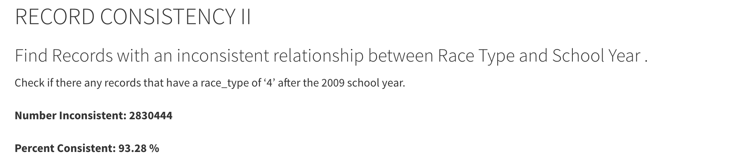
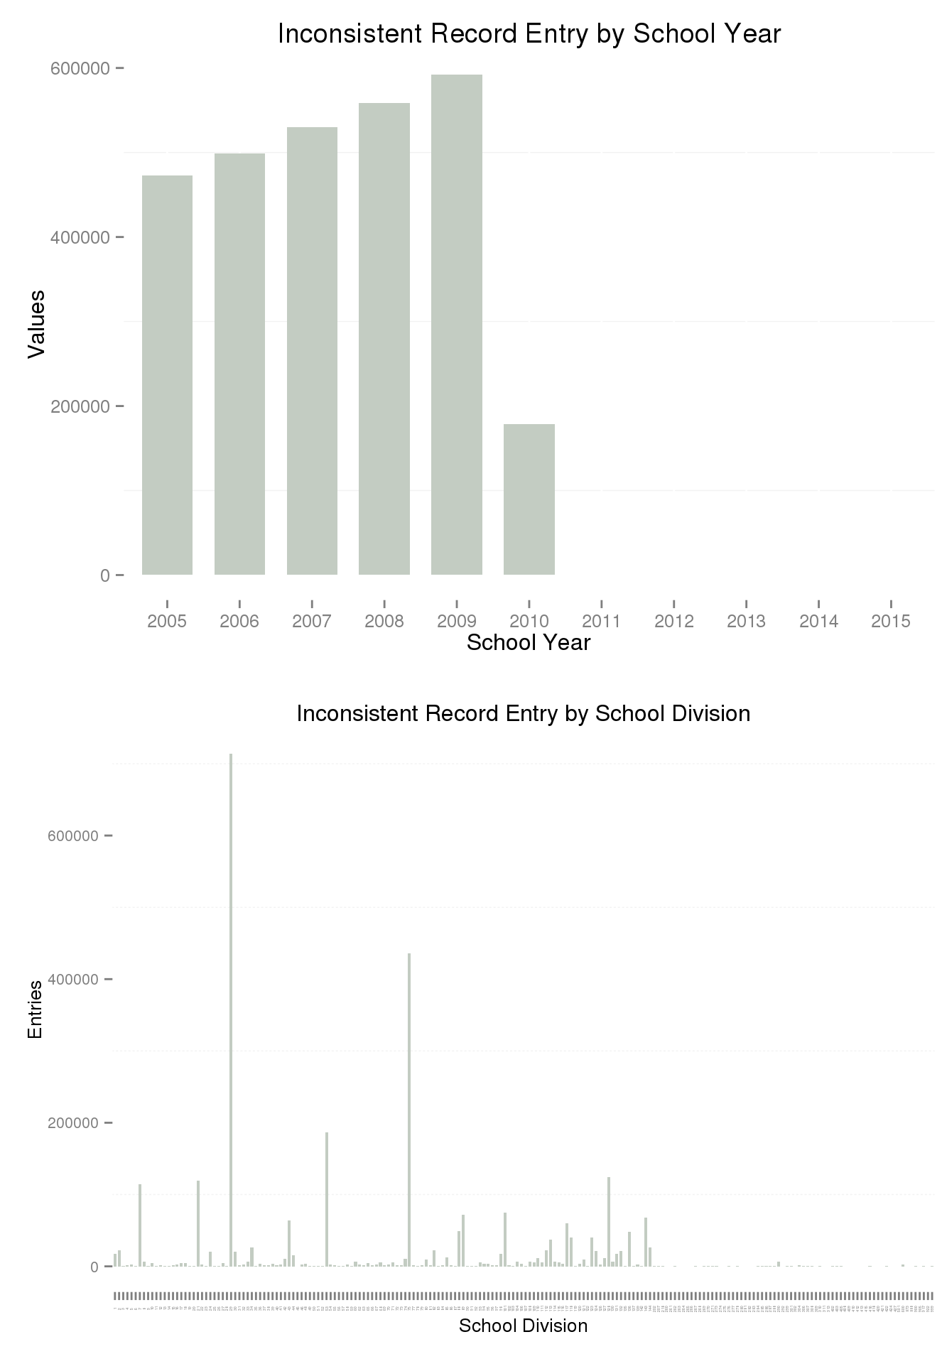
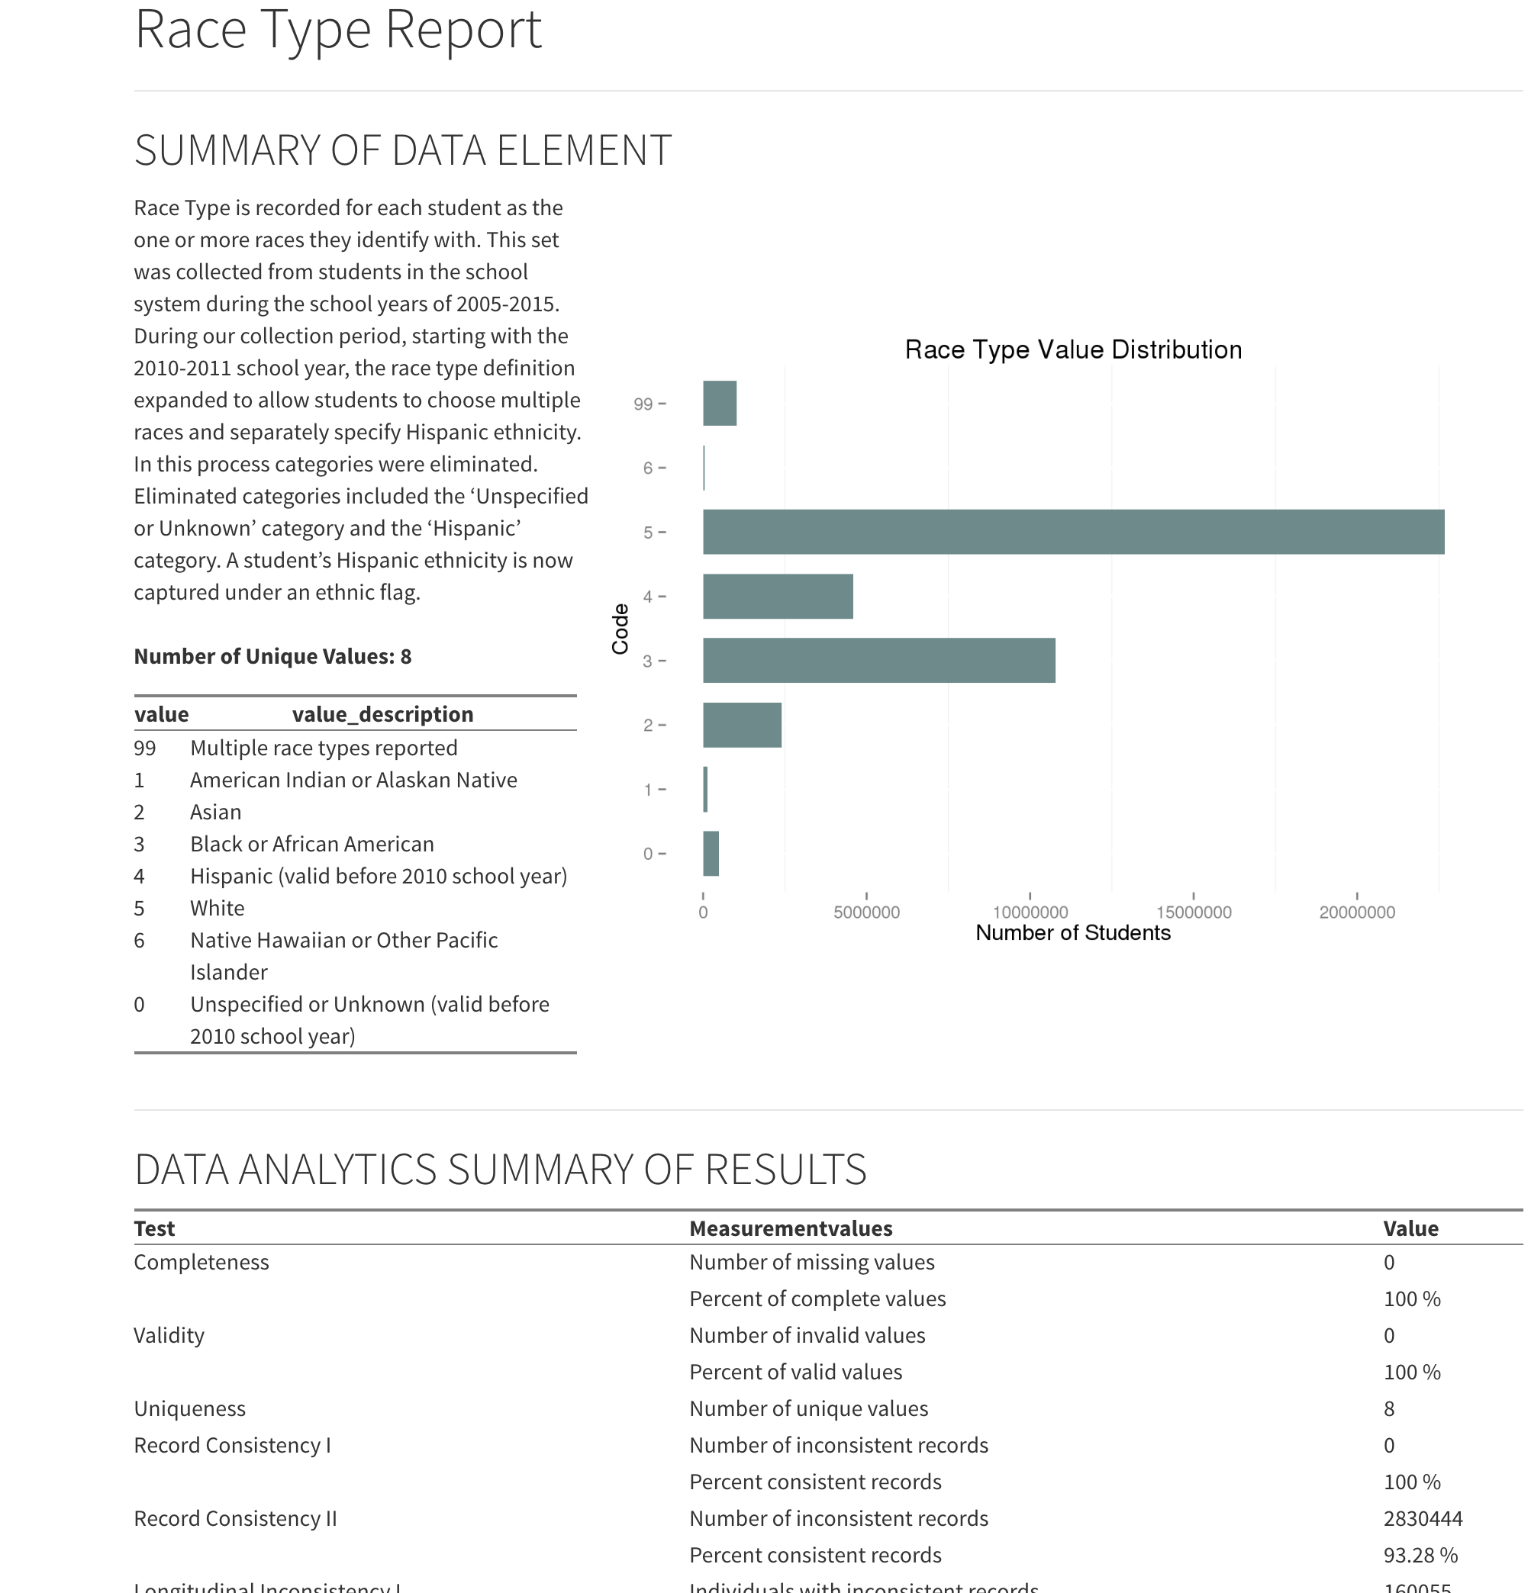
Example: Consistency Quality Analysis can only be Semi-Automated

Slide 32
Data Science Processes for Evidence-Based Policy
Data Analytics Process
Data Fitness Analysis
Data Preparation
The Data Preparation Phase includes the activities necessary to “fix” the issues of Quality, Structure, and Metadata discovered during Data Profiling – activities can include:
Cleansing
Missing Values
Date Formats
Nominal => numeric
Outliers
Inconsistent Data
De-duplication
Transformation
Aggregation
Normalization
Smoothing
Winsorization
Feature Construction
Restructuring

Slide 33

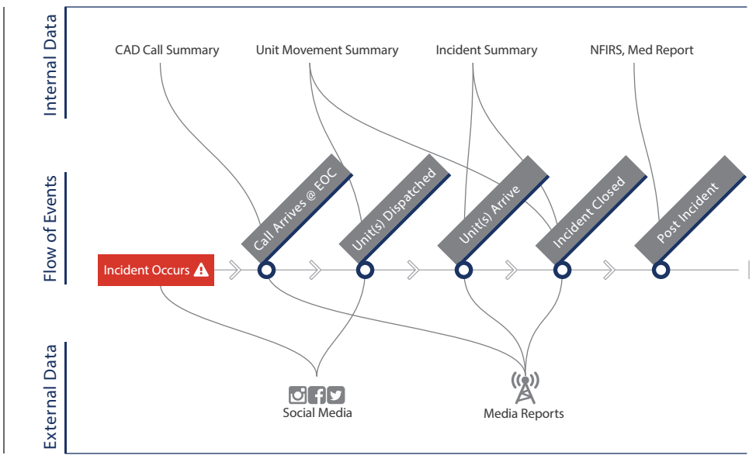
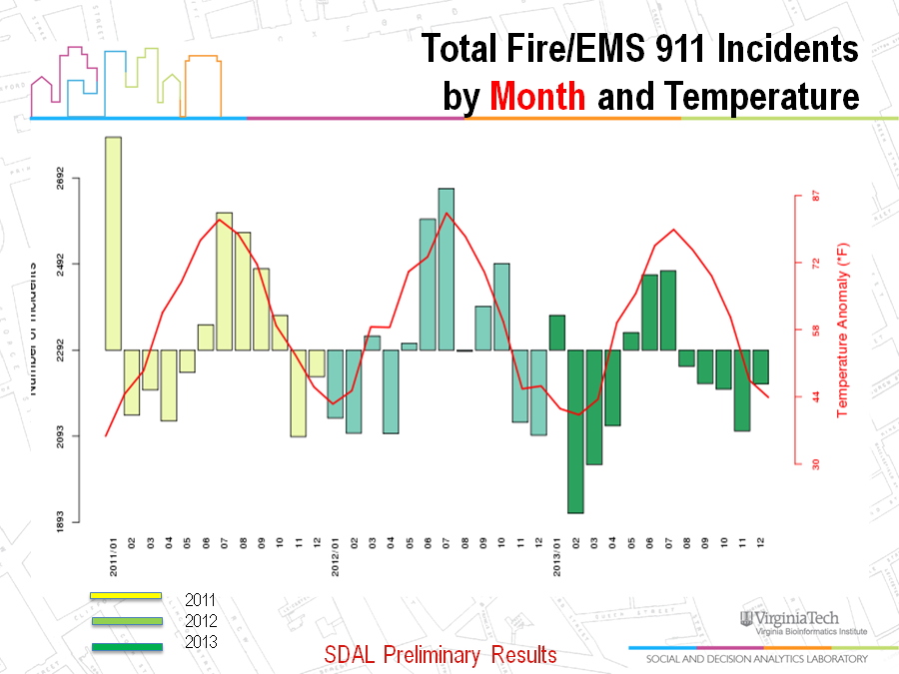
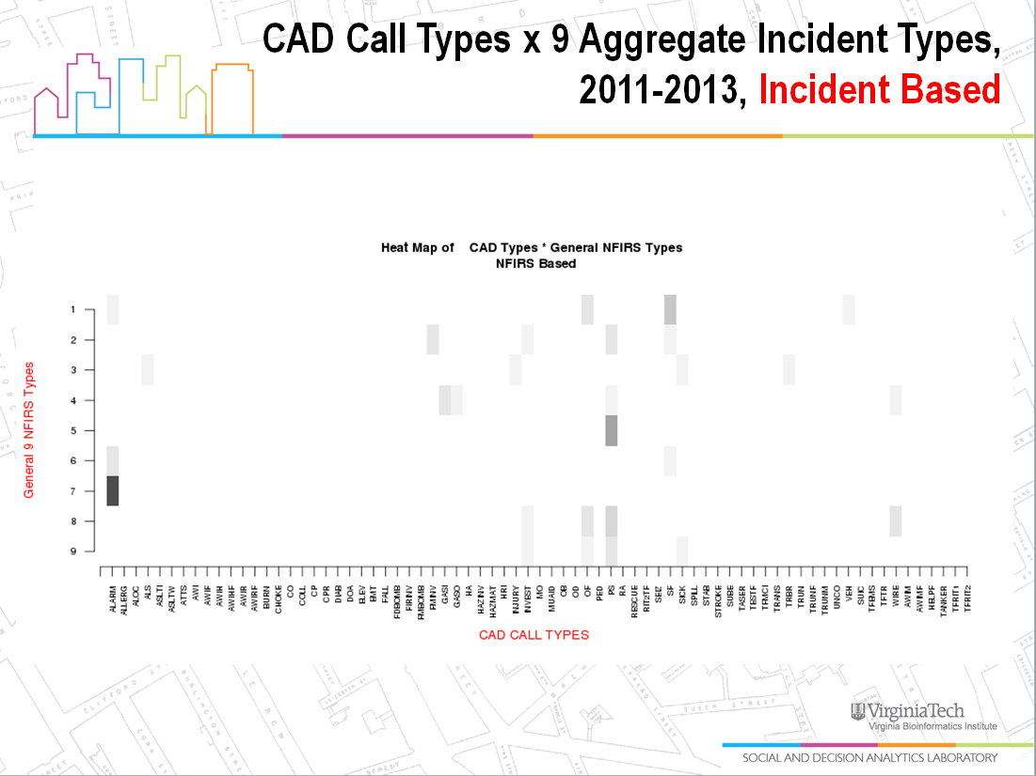
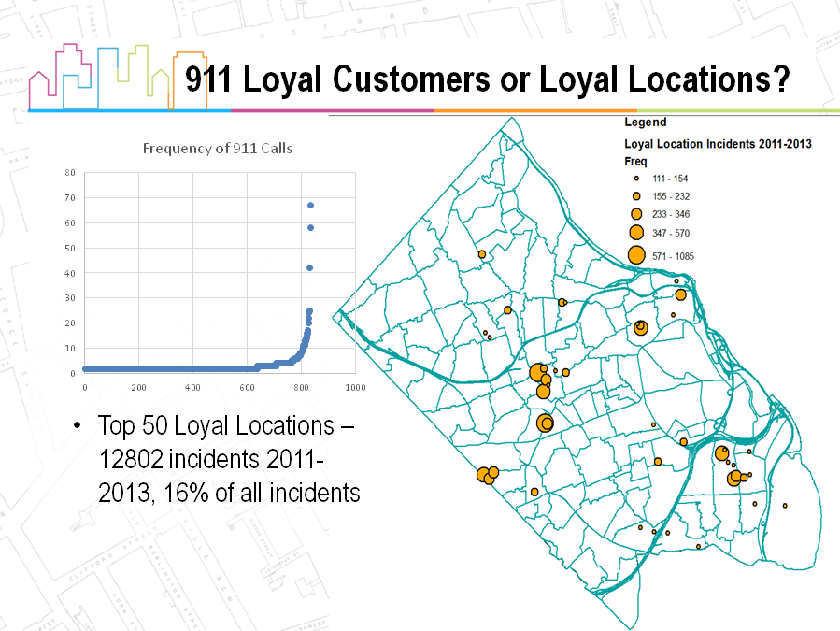
Data Science Processes & Platforms for Evidence-Based Policy
Data Analytics Process
Data Fitness Analysis
Data Analysis & Hypothesis Testing

Slide 34
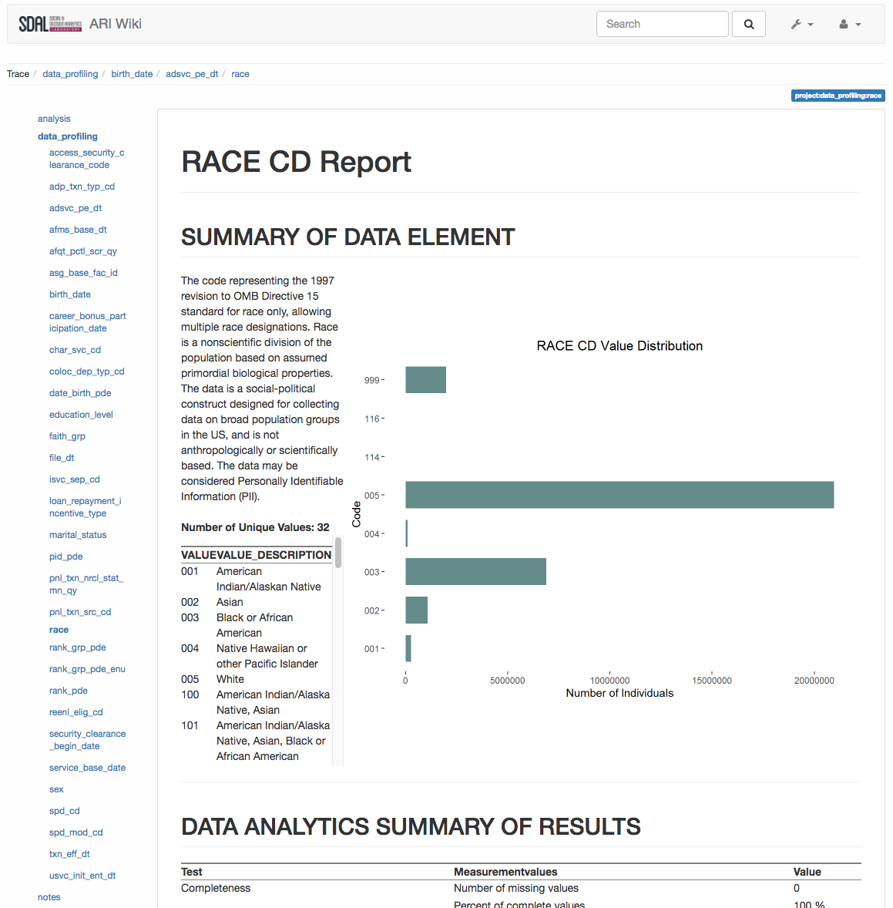
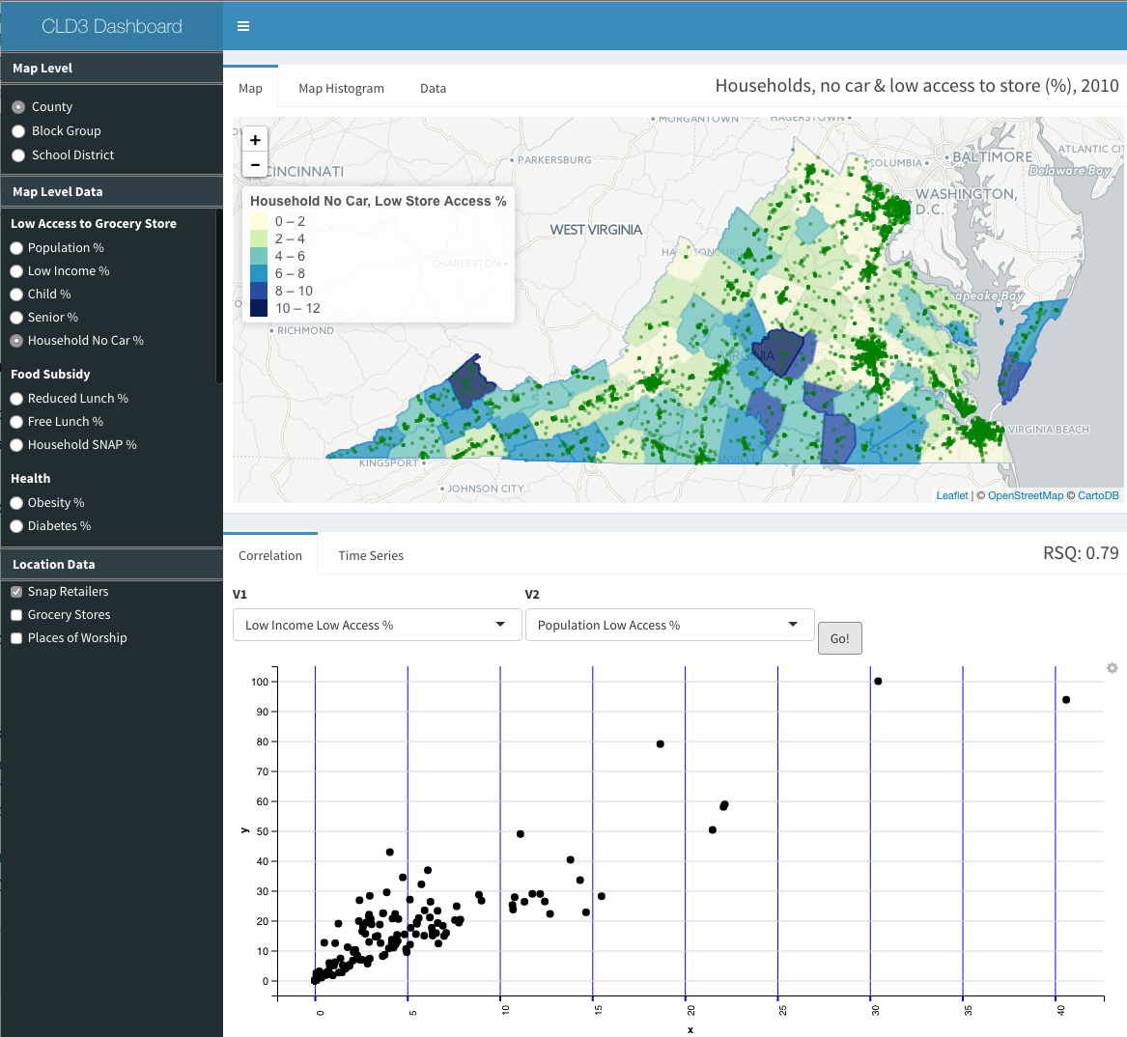
Data Science Processes & Platforms for Evidence-Based Policy
Data Presentation Process

Slide 35
CLD3 - Data Science Processes & Platforms for Evidence-Based Policy
DETAIL

